Slide 1
Information Processing Techniques
Week 02
Abeeha Sattar

Slide 2
Web Development
Work involved in developing a website
Client side languages:
HTML, CSS, JavaScript
POST and GET methods (Some HTTP Methods)
GET: https://example.com/path/itemname=shirt&color=purple
POST : has parameters in the message header
POST /test/demo_form.php HTTP/1.1 Host: w3schools.com name1=value1&name2=value2
Notes:
HTTP: Hyper Text Transfer Protocol
Other methods:
PUT to update resource HEAD is similar to GET but no response body
DELETE to delete resource
OPTIONS describes communication options for the target resource

Slide 3
Client-Side v/s Server-Side Code
Client-Side Code
Interface between server and user
Interaction with local storage
Sending requests to server
Server-Side Code
Accessing the database
Reading/Writing files on a server
Interacting with other servers
Processing user input
Notes:
Client Side languages:
1) Javascript 2) VBScript 3) HTML 4) CSS 5) AJAX
Server Side languages:
1) PHP 2) C++ 3) Java and JSP 4) Python 5) Ruby on Rails

Slide 4
Static Web Pages
A very basic type of webpage
Can be coded in HTML
Only displays the same content every time
Notes:
Example : Login Page for any website

Slide 5
Dynamic Web Pages
Content of the web page may vary from user to user
Uses client-side scripting (ASP.NET, JSP, etc)
Contains database access
Notes:
Example: Your twitter or facebook feed
Is customized for you
Comparing static and dynamic pages
Content
Language used HTML v/s PHP, ASP.NET etc
Response: same HTML or different

Slide 6
Web 1.0
The first stage of the World Wide Web
Mainly static pages
Content on the server’s file system
Frames and Tables used for Alignment

Slide 7
Web 2.0
“Participative Social Web”
Dynamic Content
Social Media
Social Networking

Slide 8
Web 3.0
Altering the web into a database
Semantic Web
AI
Using a specific ontological language
Notes:
Web 1.0 Web 2.0 Web 3.0
Mostly Read-Only Widely Read-Write Portable and Personal
Company Focus Community Focus Individual Focus
Home Pages Blogs / Wikis Live-streams / Waves
Owning Content Sharing Content Consolidating Content
Web Forms Web Applications Smart Applications
Directories Tagging User Behavior
Page Views Cost Per Click User Engagement
Banner Advertising Interactive Advertising Behavioral Advertising
Britannica Online Wikipedia The Semantic Web
HTML/Portals XML / RSS RDF / RDFS / OWL

Slide 9
ASP .NET Architecture
VB
C++
C#
JScript
…
Common Language Specification
ASP.NET: Web Services
And Web Forms
Windows
Forms
Visual Studio .NET
ADO.NET Data and XML
Base Classes
Common Language Runtime

Slide 10
Full Postback
a postback is an HTTP POST to the same page that the form is on
A full postback leads to refreshing the whole page

Slide 11
Partial Postback
When you do not want to refresh the whole page
Only the specified section is refreshed
Notes:
For example, facebook comments

Slide 12
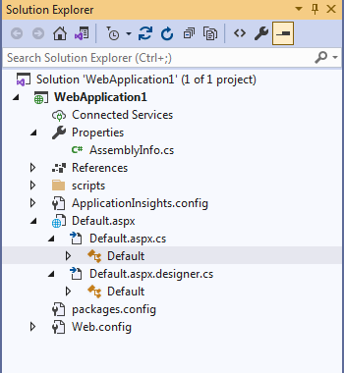
Full Postback Demo

Slide 13
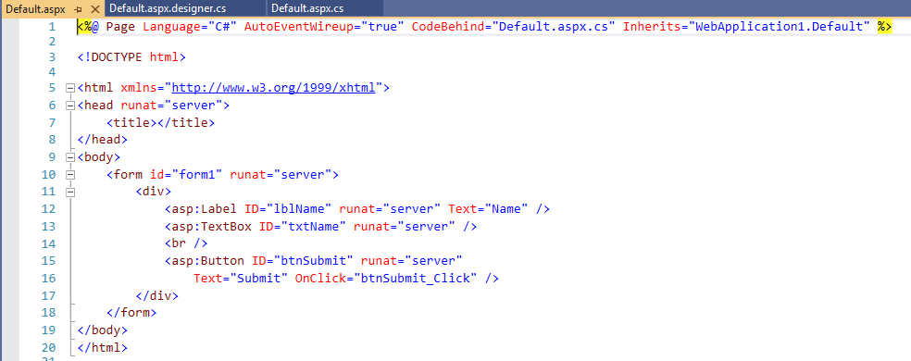
Full Postback Demo

Slide 14
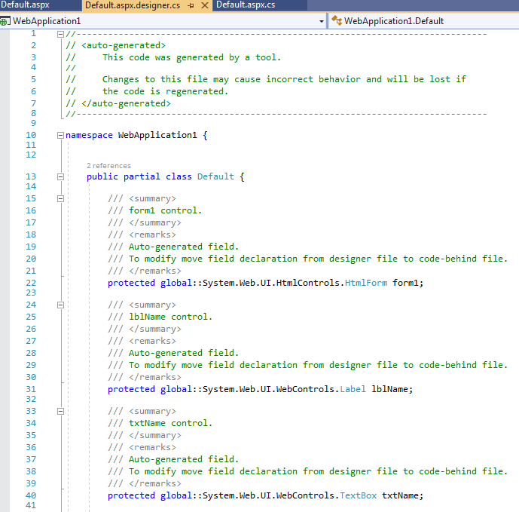
Full Postback Demo

Slide 15
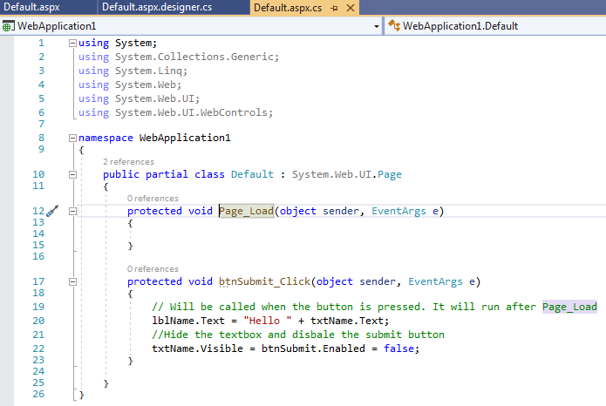
Full Postback Demo

Slide 16
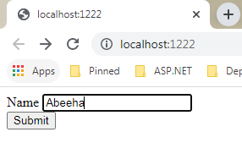

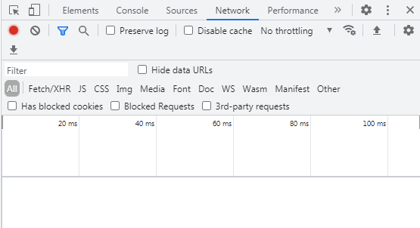
Full Postback Demo

Slide 17
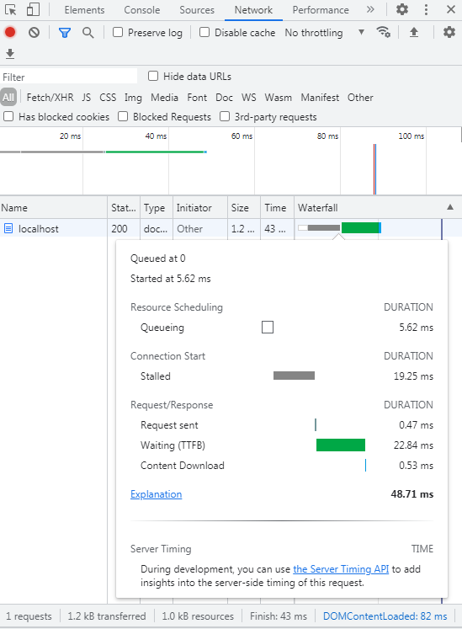
Full Postback Demo

Slide 18
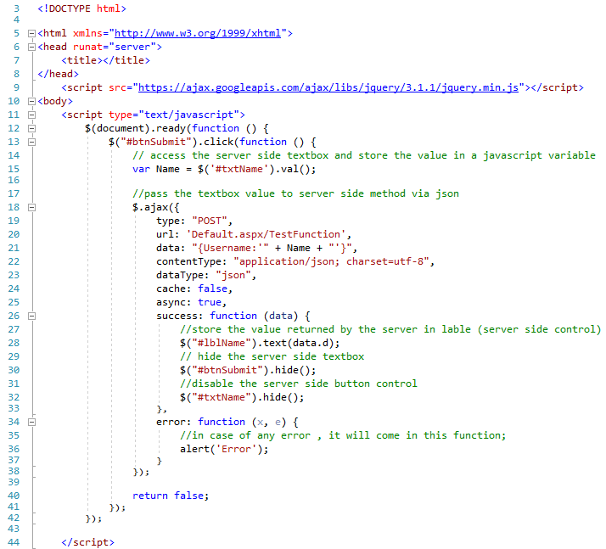
Partial Postback Demo

Slide 19
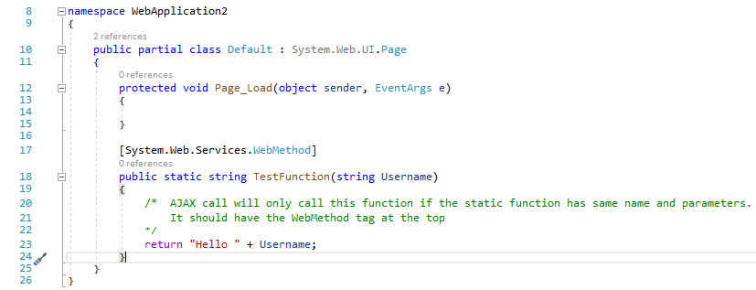
Partial Postback Demo

Slide 20
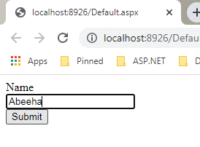

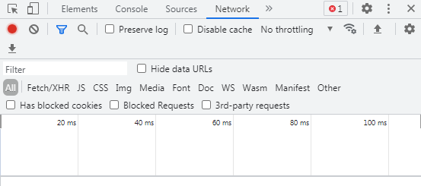
Partial Postback Demo

Slide 21
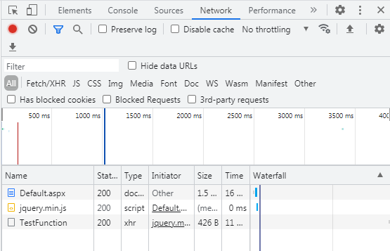
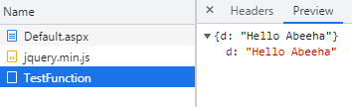
Partial Postback Demo

Slide 22
ASP.NET - MVC Pattern
Model
View
Controller

Slide 23
Model
Represents the data
Rules for updating and accessing data
Software approximation of a real-world process

Slide 24
View
Reflection of the Data Model
Renders and displays the content of the model
Changes to model should be reflected by the view

Slide 25
Controller
Translates user interaction into actions that the model will perform
Controls the data flow into model
Updates the view if data in the model changes

Slide 26
View Model
One to one data mapping from view to model.
Each object in a view will have a object in the model class
It is not the same as the models being stored on the DBMS

Slide 27
DB Models
The logical structure of a database
ER Models, schemas etc.

Slide 28
IIS v/s IIS Express
IIS Express – On Visual Studio
IIS – You will need to activate this on Windows before you can deploy a website

Slide 29
app.config and web.config
Why do we use config files?
key-value pairs
json or xml format

Slide 30
Fin.

